Slide 1
Ideation for 3 Axis Pin Dev.
Week #0

Slide 2

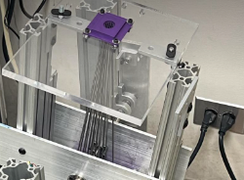
Defining Constraints
Shape of Array
Currently hexagonal for stability (severe warping)
Rods
Parallel to each other closer to array
Voice-Coil Actuators for Z-axis movement
Latency
200 Hz? Required for sufficient haptic stimulation

Slide 3
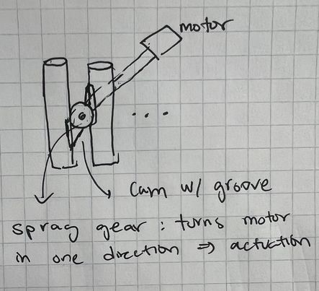
Actuation #1: Motors
In between two rods
Cam + Spag bearing / clutch
Independent motion of rods
Requires N motors (for NxN array)

Slide 4
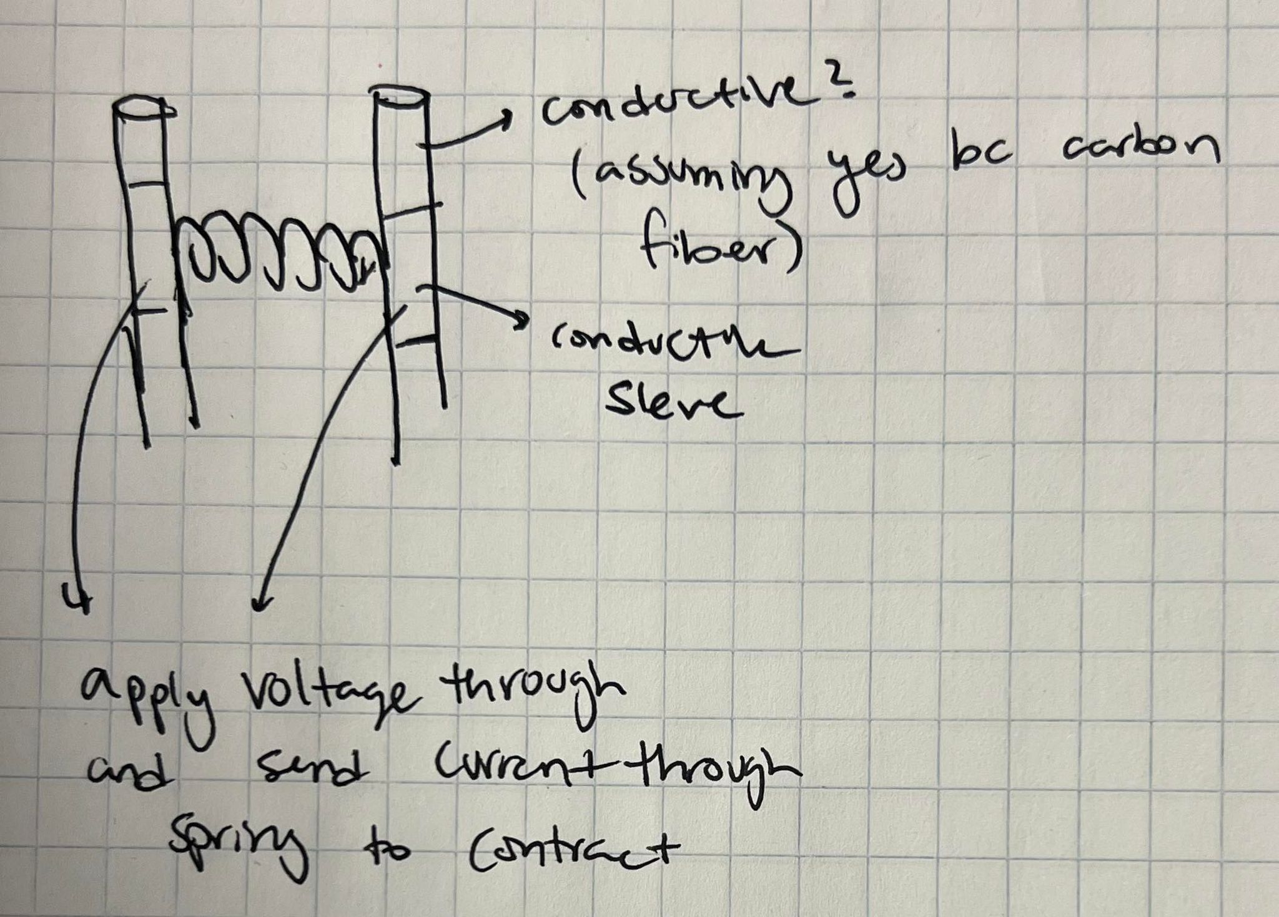
Actuation #2: Contracting Springs
Current through metal spring
Spring length longer than d
F by magnetic field = I x B
B = μ₀nI
F = -k * Δx
Vary I to compress spring

Slide 5
Independent vs Synchronous
Independent requires as many actuators as rods
48 actuators for an 8x8 square grid
Synchronous can allow for

